Slide 1

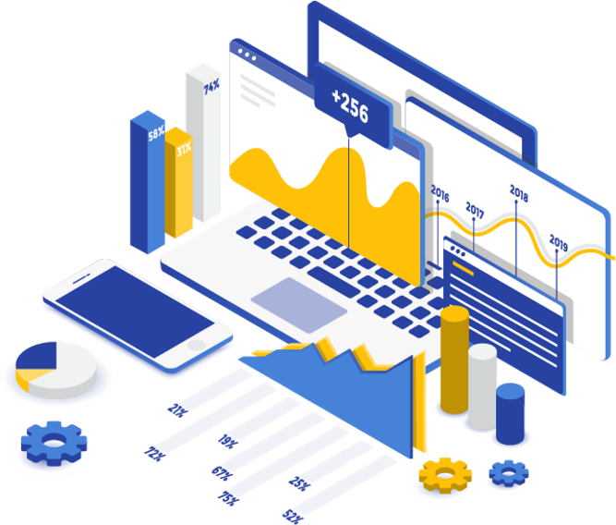
INT317
DATA MINING AND ANALYTICS

Slide 2
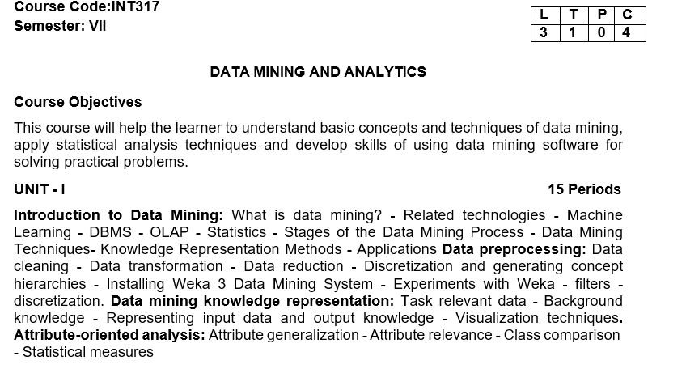
Syllabus

Slide 3
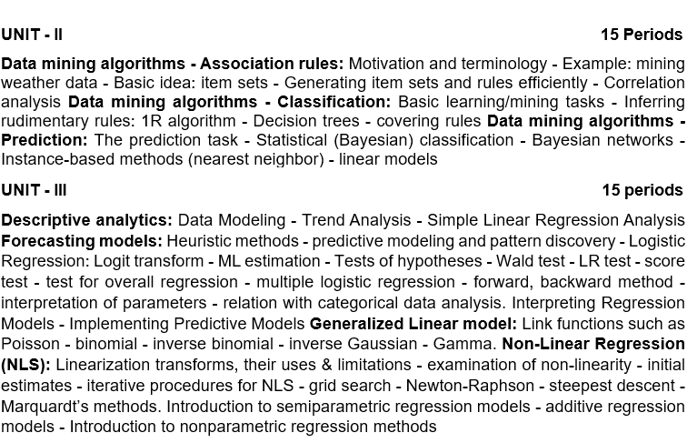
Syllabus

Slide 4
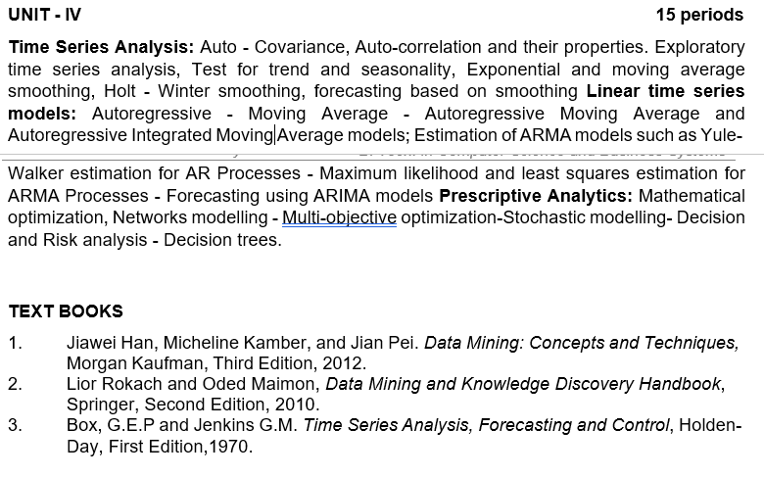
Syllabus

Slide 5
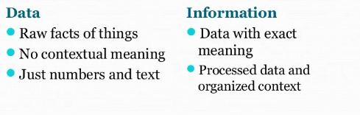
Data vs. Information
Example:
A list of exam scores (85, 92, 78, 95, 88) is data.
The average score (87.6), highest score (95), or pass/fail status derived from that list is information

Slide 6
Data Analytics
Data analytics is the process of examining raw data to identify trends, patterns, and insights that can be used to make informed decisions and solve problems.
It involves collecting, cleaning, transforming, and analyzing data using various techniques to extract meaningful information

Slide 7
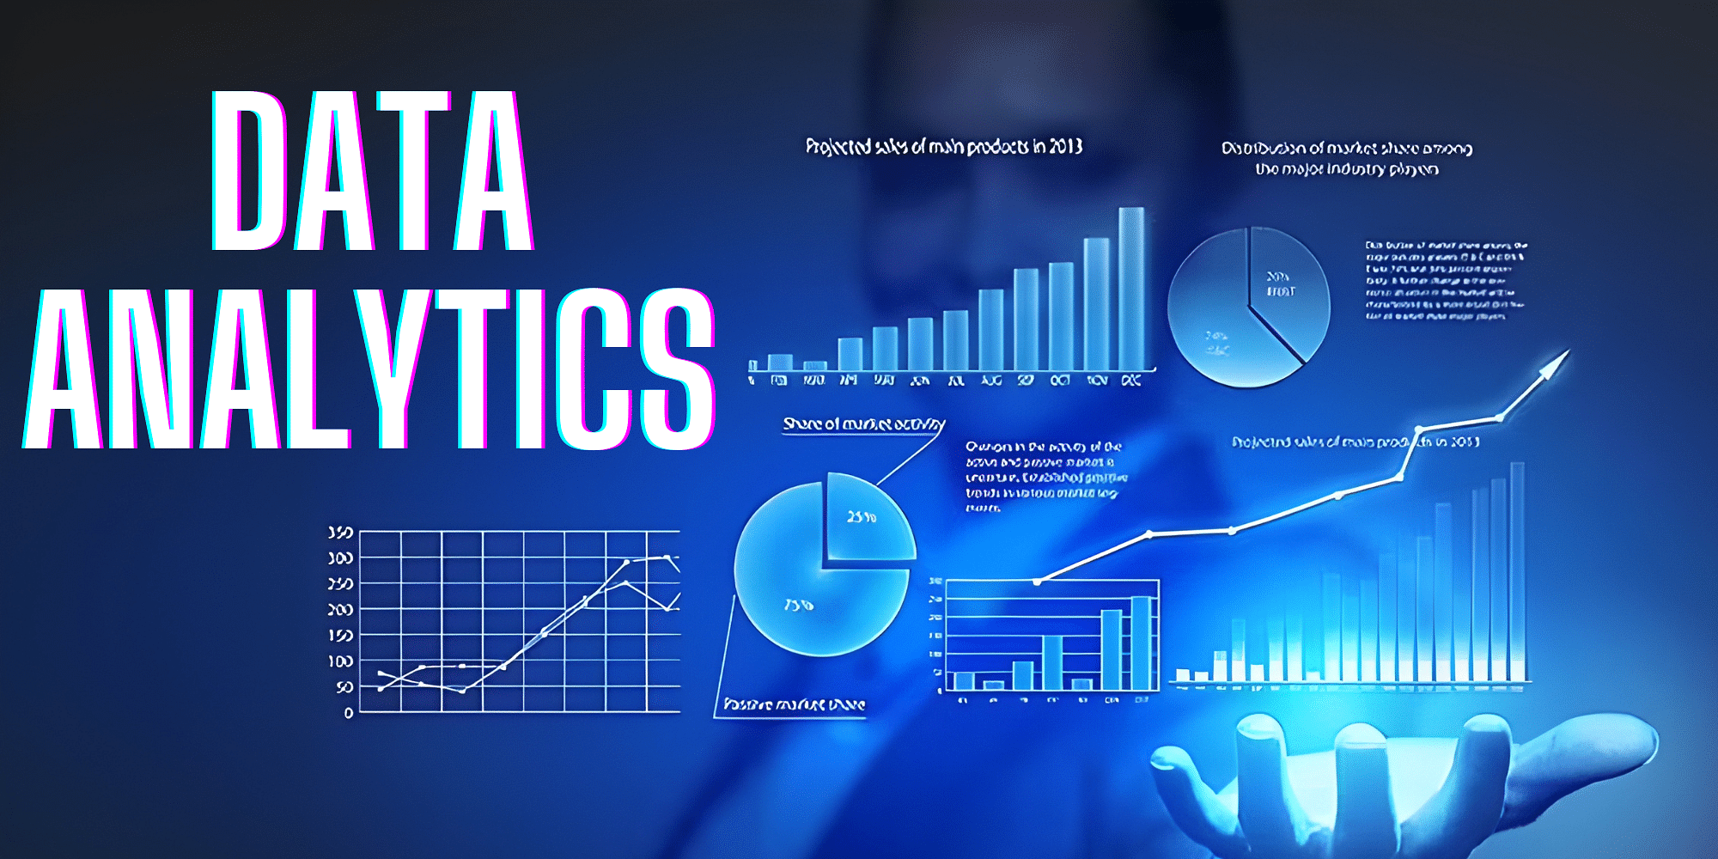
Data Analytics

Slide 8
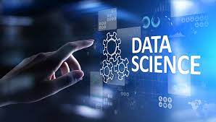
Data Science
Data science is the study of data to extract meaningful insights for business. It is a multidisciplinary approach that combines principles and practices from the fields of mathematics, statistics, artificial intelligence, and computer engineering to analyze large amounts of data.

Slide 9
Data Science Vs Data Analytics
Data science and data analytics are related fields focused on extracting insights from data, but they differ in scope and objectives.
Data science is a broader field that encompasses data analytics, using advanced techniques like machine learning and predictive modeling to build models and solve complex problems.
Data analytics, on the other hand, focuses on analyzing historical data to understand past trends and inform current business decisions

Slide 10
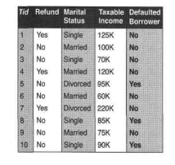
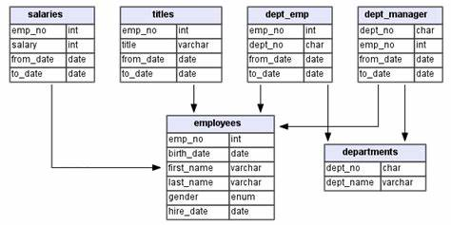
Datasets
A data set (or dataset) is a collection of data. In the case of tabular data, a data set corresponds to one or more database tables, where every column of a table represents a particular variable, and each row corresponds to a given record

Slide 11
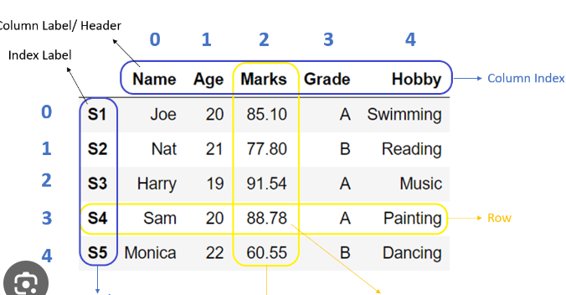
Dataframe
A DataFrame is a data structure that organizes data into a 2-dimensional table of rows and columns, like a spreadsheet

Slide 12
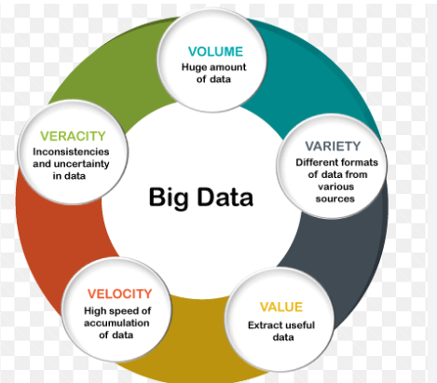
Big Data

Slide 13
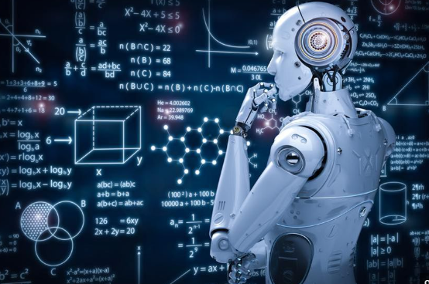
Machine Learning
Machine learning is a branch of artificial intelligence (AI) and computer science which focuses on the use of data and algorithms to imitate the way that humans learn, gradually improving its accuracy.

Slide 14
Chapter 1: Introduction
What Is Data Mining?
Why Data Mining?
What Kind of Data Can Be Mined?
What Kinds of Patterns Can Be Mined?
Which Technologies Are Used?
Which Kinds of Applications Are Targeted?
Major Issues in Data Mining
Summary

Slide 15

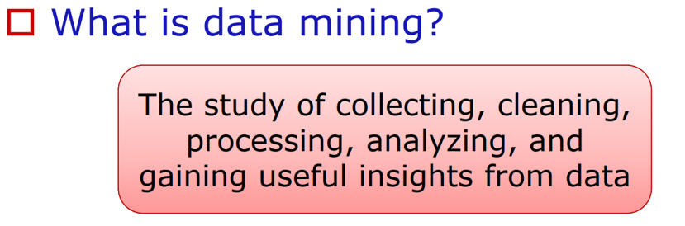
Introduction

Slide 16
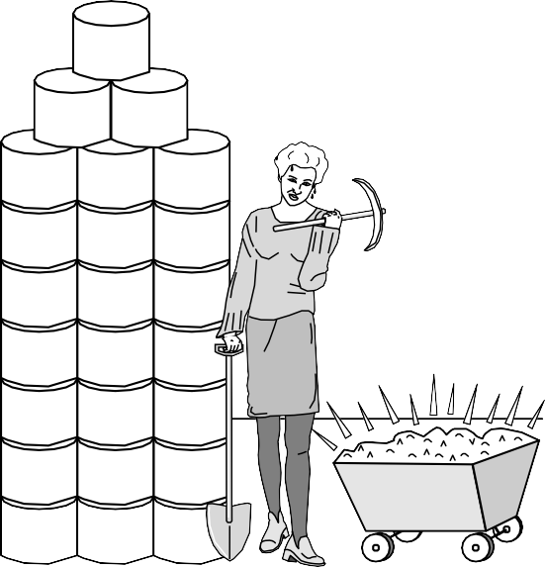
Introduction - What is Data mining?
Data mining (knowledge discovery from data)
  discovering of interesting (non-trivial, implicit, previously unknown and potentially useful) patterns and knowledge from large amount of data
Alternative names
Knowledge discovery (mining) in databases (KDD), knowledge extraction, data/pattern analysis, data archeology, data dredging, information harvesting, business intelligence, etc.
Watch out: Is everything “data mining”?
Simple search and query processing
(Deductive) expert systems (systems applying
predefined rules)
Knowledge

Slide 17
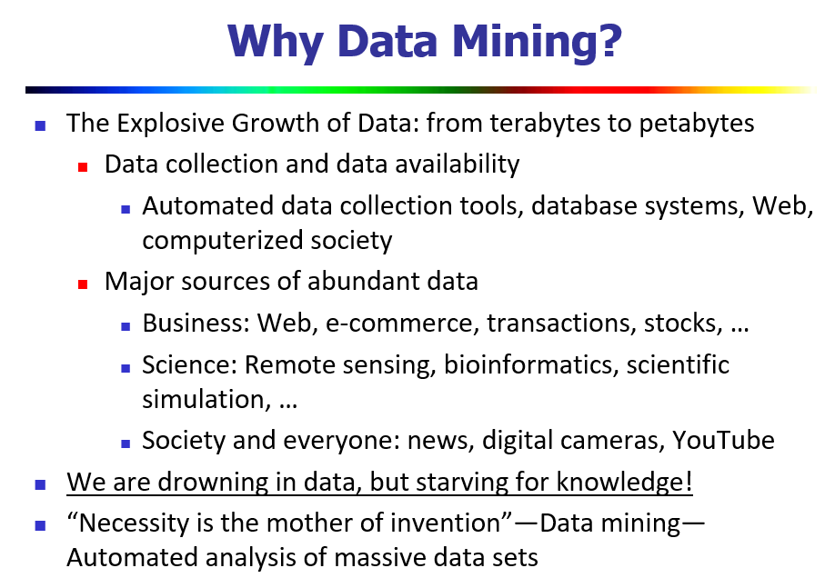
Introduction

Slide 18
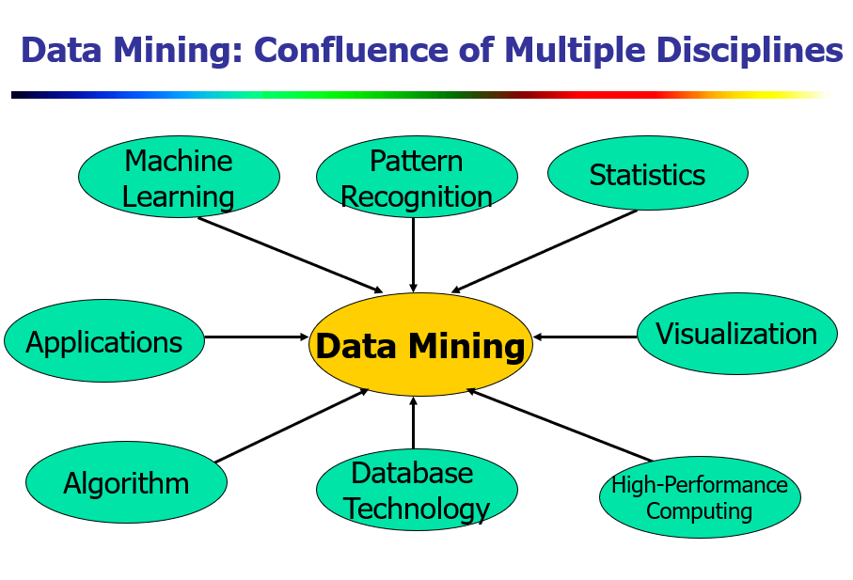
Introduction

